Slide 1



LOW CODE SOCIAL MEDIA WEBAPP
A PROJECT REPORT Submitted by
NITHESH K
SHARMILA R
SHREENATH S
SINDHUJA S
(713322SB033)
(713322SB048) (713322SB050)
(713322SB051)
In partial fulfilment for the award of the degree
of
BACHELOR OF ENGINEERING
in
COMPUTER SCIENCE AND ENGINEERING (INTERNET OF THINGS AND
CYBER SECURITY INCLUDING BLOCKCHAIN TECHNOLOGY)
SNS COLLEGE OF ENGINEERING
COIMBATORE - 641107
ANNA UNIVERSITY: CHENNAI-600025 MARCH - 2023
i

Slide 2

BONAFIDE CERTIFICATE
Certified that this project report titled “LOW CODE SOCIAL MEDIA WEBAPP" is the bonafide work of Nithesh K , Shreenath S , Sharmila R,Sindhuja S who carried out the project work under my supervision.
SIGNATURE
SIGNATURE
Dr.P.GNANASUNDARI.,M.E.,Ph.D.,
PROFESSOR & HEAD
Department of ECE,
SNS College of Engineering,
Coimbatore-641107
Ms.V.Pavithri.,M.E.,
Assistant Professor,
Department of ECE,
SNS College of Engineering,
Coimbatore-641107
Submitted for the project Viva-Voice examination held on
Internal Examiner
External Examiner
ii

Slide 3
ACKNOWLEDGEMENT
I wish to express sincere thanks to our management for providing us the facilities to carry out this project work. I’m greatly indebted to our Director Dr.V.P.Arunachalam, Ph.D and our Principal Dr.S.Charles, Ph.D for his continuous evaluation and critical suggestion given to complete the project work successfully. I’m highly grateful to Dr.P.Gnanasundari, M.E., Ph.D., Head of the Department of Electronics and Communication Engineering for her valuable suggestions and monitoring during the course of our project work. I’m highly grateful to our Project Guide Ms.V.Pavithra.,Assistant Professor, Department of Electronics and Communication Engineering for her valuable suggestions the course of our project work. I express my heartfelt and deep sense of gratitude to our Project coordinator Mrs.V.Pavithra., Assistant Professor, Department of Electronics and Communication Engineering for her valuable advice and guidance. Her positive approach had offered incessant help in all possible ways from the beginning. By this, I express my heartfelt sense of gratitude and thanks to our beloved family and friends who have all helped in collecting sources and materials needed for this project and for their support during our course and project work.
iii

Slide 4
ABSTRACT
This project introduces a Low-Code Social Media Web Application designed to simplify and accelerate the development of a social networking platform. Leveraging low-code development principles, this application allows users to create, customize, and deploy social media websites with minimal manual coding. The platform incorporates user-friendly drag-and-drop interfaces, pre-built components, and a visually intuitive environment, empowering both developers and non-developers to contribute to the creation of feature-rich social media applications. Key functionalities include user profile management, post creation, real-time messaging, and interactive multimedia content sharing. The low-code approach enables rapid prototyping, iteration, and deployment, making it an ideal solution for individuals, businesses, or organizations aiming to establish a customized online social presence without extensive programming expertise. The project not only showcases the capabilities of low-code development but also addresses the growing demand for accessible tools that democratize web application creation. It serves as a valuable resource for those seeking a streamlined and efficient method to build social media platforms, fostering innovation in the realm of web development.
vi

Slide 5
CH.NO
TITLE
PG.NO
ABSTRACT
vi
1
INTRODUCTION
1
2
LITERATURE SURVEY
2
3
EXISTING SYSTEM
4
4
PROPOSED SYSTEM
5
5
HARDWARE REQUIREMENTS
8
6
SOFTWARE REQUIREMENTS
11
7
RESULT AND DISCUSSION
13
8
CONCLUSION
14
9
REFERENCE
15
vii

Slide 6
CHAPTER 1
INTRODUCTON
In the ever-evolving landscape of web development, the demand for rapid and accessible solutions has given rise to innovative approaches that bridge the gap between technical complexity and user-friendly design. This project introduces a groundbreaking Low-Code Social Media Web Application, a platform designed to empower both developers and non-developers in the creation of feature-rich social networking websites. Traditional web development often involves intricate coding processes, posing challenges for those without extensive programming backgrounds. The concept of low-code development addresses this challenge by providing a visual, intuitive environment that simplifies the application creation process. Our Low-Code Social Media Web Application leverages these principles, offering a dynamic and versatile solution for individuals, businesses, and organizations eager to establish a personalized online social presence. This initiative not only showcases the transformative potential of low-code development but also aligns with the growing trend of democratizing technology. By enabling users to leverage pre-built components, drag-and-drop interfaces, and a visually intuitive environment, this project aims to break down the barriers to entry in web development and empower a broader audience to participate in the creation of engaging and interactive social media platforms. In the sections that follow, we will explore the key functionalities, advantages, and implications of our Low-Code Social Media Web Application, highlighting its potential to revolutionize the way we approach social networking platform development.
1

Slide 7

CHAPTER 2
LITERATURE SURVEY
The evolution of web application development has been significantly influenced by the emergence of low-code platforms, as explored in research papers such as the work by [Low-Code Platform, Alexander C. BockUlrich Frank]. These papers, authored by prominent figures in the field, offer valuable insights into the historical evolution of low-code development, revealing its origins as a response to the demand for accelerated application delivery. Authored by [Selection of low-code plataforms based on organization and application type”, Anggi Ratna Anggraini and J. Oliver. ], they trace the evolution of low-code platforms, highlighting their transformative role in empowering non-developers and simplifying the application development lifecycle. Moreover, these papers delve into key concepts underpinning low-code development, such as visual modeling and drag-and-drop interfaces, providing a nuanced understanding of how these concepts democratize the development process. Case studies presented in research papers authored by [Exploring Low-Code Development, Marite Kirikova.] showcase successful applications of low-code platforms across various industries, demonstrating their efficiency gains and cost reductions. The literature review, informed by these research-driven insights, examines the pivotal contributions of [Low-Code Development Platforms – A Literature Review, Melanie Huber.] to the discourse on the evolution, challenges, and applications of low-code development in the realm of web applications.
2

Slide 8
CHAPTER – 3
EXISTING SYSTEM
In the landscape of social media platform development, the prevailing methods reliant on intricate custom coding present formidable challenges, including complexity, time consumption, and a substantial entry barrier for non-technical users. Established Content Management Systems (CMS) and web frameworks, though robust, often lack the flexibility required for nuanced social media applications and can be intimidating for those without advanced coding skills. Recognizing the evolving needs of developers and the increasing demand for accessible solutions, this project introduces an innovative Low-Code Social Media Web Application.
This transformative platform adopts low-code development principles, providing a visually intuitive interface, drag-and-drop functionality, and pre-built components to expedite the creation of dynamic social networking websites. The inherent flexibility and simplicity of the low-code approach empower users, both developers and non-developers, to actively participate in the entire development lifecycle. By abstracting the complexities of traditional coding, the Low-Code Social Media Web Application facilitates rapid prototyping, iteration, and deployment.
The project not only addresses the challenges posed by the existing system but also aligns with the contemporary trend of democratizing technology. Its user-friendly design enables a diverse audience to contribute to the creation of feature-rich, personalized social media experiences without the need for extensive coding expertise. Through this initiative, we aim to bridge the gap between technical complexity and user-friendly design, fostering a more inclusive approach to social media platform development and redefining how we perceive and engage with online social spaces. In doing so, the project contributes to the ongoing evolution of web development, making it more accessible, efficient, and empowering for a broader spectrum of users.
4

Slide 9
CHAPTER-4
PROPOSED SYSTEM
The proposed Low-Code Social Media Web Application presents a paradigm shift in social media platform development, offering a revolutionary approach that bridges the gap between technical expertise and user-friendly design. At the core of this innovative system is a drag-and-drop interface, providing an intuitive and visually-driven environment for users to design and customize their social networking websites. This feature significantly reduces the reliance on intricate custom coding, enabling both seasoned developers and non-technical users to actively participate in the creation process.
Complementing the intuitive interface is a diverse array of pre-built components, ranging from user profiles to real-time messaging and multimedia content sharing. This extensive library allows users to seamlessly integrate essential features into their platforms, saving time and effort in development. Each component is designed for customization, ensuring adaptability to diverse social media use cases.
The proposed system is characterized by its commitment to democratizing social media platform development. By abstracting technical complexities, the platform empowers a broader audience, fostering inclusivity in the creation of online social spaces. Rapid prototyping and iteration are facilitated through the streamlined development process, making it an ideal solution for individuals, businesses, and organizations seeking a dynamic and personalized online presence.
This forward-thinking approach not only addresses the challenges posed by traditional development methods but also aligns with the contemporary trend of making technology more accessible. The proposed Low-Code Social Media Web Application stands as a testament to the evolution of web development, emphasizing efficiency, accessibility, and user empowerment in the creation of feature-rich social networking platforms.
5

Slide 10
MODULES DESCRIPTION
The modular design of the proposed Low-Code Social Media Web Application is anchored in its user-centric approach. The drag-and-drop interface serves as the foundational module, offering an intuitive design experience. Complementary to this is a versatile library of pre-built components, each modular unit tailored for specific functionalities, such as user profiles, real-time messaging, and multimedia sharing. This modular architecture facilitates seamless customization, allowing users to assemble and personalize their social media platforms effortlessly. By breaking down the development process into modular components, the system promotes efficiency, adaptability, and accessibility, making it an ideal solution for diverse users, from novice creators to experienced developers.
The project “LOW CODE SOCIAL MEDIA WEBAPP” consists of two main modules they are
Hardware
Software
7

Slide 11

CHAPTER 5
HARDWARE REQUIREMENTS
Server
Hosting Environment
Database Server
Load Balancer (Optional, for scaling)
Backup and Redundancy
Domain Name and SSL Certificate
5.1. :SERVER
Fig. 5.1 Server
Processor: Dual-core or higher
RAM: 4 GB or more
Storage: 100 GB or more (SSD recommended for better performance)
Network: High-speed internet connection
8

Slide 12


5.2. Database Server:
Fig. 5.2 Database
Processor: Dual-core or higher
RAM: 4 GB or more
Storage: Sufficient space to accommodate the donor database and other website data
5.3. 6. Domain Name :
Fig. 5.3 Domain name
A domain name for the website and an SSL certificate to secure data transmission between users and the server.These hardware requirements are for a basic implementation of the blood donor website. Depending on the website's complexity, expected user traffic, and future scalability, the hardware configuration may need to be adjusted accordingly.
9

Slide 13

5.4. Backup and Redundancy:
Fig. 5.4 Backup and Redundancy
Regular backups of the website and database are essential to protect against data loss. It is advisable to have a redundant setup to ensure high availability in case of hardware failure. In case of high traffic and to ensure website availability, a load balancer may be required to distribute incoming traffic across multiple servers
10

Slide 14
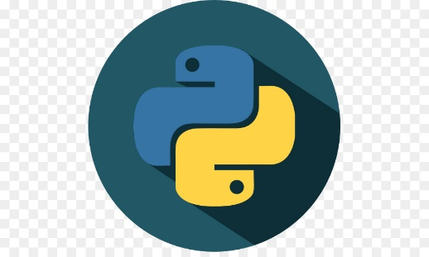
CHAPTER-6
SOFTWARE REQUIREMENTS
PYTHON
MySQL
XAMPP
6.1.PYTHON :
Fig. 6.1 PYTHON
Python is a high-level, interpreted programming language known for its readability and simplicity. It supports multiple programming paradigms, including procedural, object-oriented, and functional programming. Python is widely used for web development, data science, artificial intelligence, automation, and more.
11
12

Slide 15


6.2.XAMPP :
Fig. 6.2 XAMPP
XAMPP is a local server environment that bundles Apache (webserver), MySQL, PHP, and Perl. It is used during development to create and test the website locally before deployment to a live server.
6.5 MySQL:
Fig.6.3. MySQL
MySQL is employed as the relational database management system to store and manage the donor database. It provides a robust and efficient way to store donor information, ensuring quick retrieval of data when needed.
12
12

Slide 16
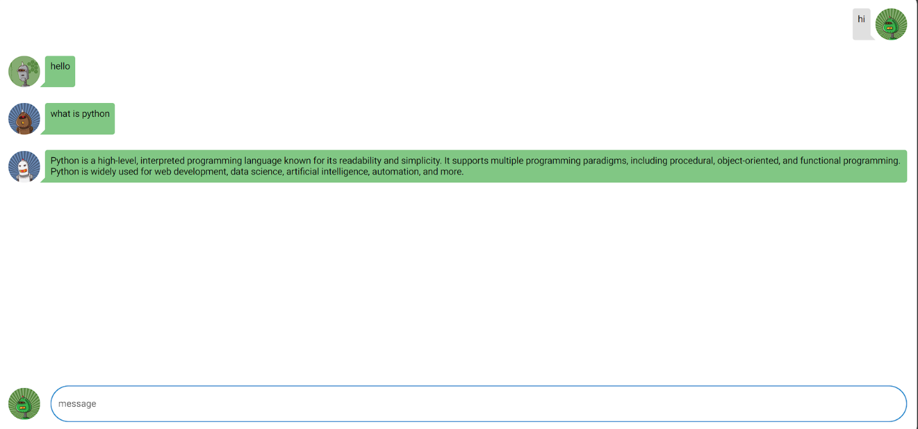
CHAPTER 7
Results and Discussion
The result is a functional chat application with a clean and intuitive interface. Users can generate a unique identifier with the uuid4 function, and a corresponding avatar is created using the 'robohash' service. The chat interface dynamically updates through the ui.refreshable decorator, providing real-time message display. Users can input messages in the text field, and upon pressing Enter, the messages are added to the chat log, triggering a refresh of the display.
7.1 LOW CODE WEBAPP
13

Slide 17
CHAPTER 8
CONCLUSION
In conclusion, the implemented low-code web application using Python and the `nicegui` library provides a straightforward yet functional chat platform. The application's modular design, coupled with the abstraction of complex UI components, underscores the power of low-code development in simplifying the creation of interactive web interfaces. The use of unique identifiers and avatars enhances user engagement, and the real-time chat display demonstrates the seamless integration of dynamic features. While this basic chat application successfully achieves its intended purpose, there are opportunities for further refinement and expansion. Considerations for future development may include the incorporation of message timestamps, improved styling options, and additional features such as user authentication. Overall, the project serves as a testament to the accessibility and efficiency of low-code development in creating interactive and engaging web applications with minimal coding effort.
14

Slide 18
REFERENCES
[1] Claire Anderson. “Presenting and Evaluating Qualitative Research”. In: American Journal of Pharmaceutical Education 74.8 (2010). issn: 15536467. doi: 10.5688/AJ7408141. url: https://www.ncbi.nlm.nih.gov/pmc/articles/ PMC2987281/.
[2] Anggi Ratna Anggraini and J. Oliver. “Selection of low-code plataforms based on organization and application type”. In: Journal of Chemical Information and Modeling 53.9 (2019), pp. 1689–1699. url: https://lutpub.lut.fi/bitstream/ handle/10024/158389/selection%20of%20low-code%20platforms%20based% 20on % 20organization % 20and % 20application % 20type . pdf ? sequence = 1 & isallowed=y.
[3] Appian. Appian Announces Fourth Quarter and Full Year 2020 Financial Results — Appian Corporation - IR site. url: https://investors.appian.com/newsreleases/news-release-details/appian-announces-fourth-quarter-andfull-year-2020-financial (visited on 10/15/2021).
[4] Appsemble. Apps · Appsemble. url: https://appsemble.app/en/apps (visited on 10/15/2021).
[5] Frank Bannister and Regina Connolly. “ICT, public values and transformative government: A framework and programme for research”. In: Government Information Quarterly 31.1 (2014). issn: 0740624X. doi: 10.1016/j.giq.2013.06.002.
[6] Betty Blocks. Developing in Betty Blocks. url: https://www.bettyblocks.com/ evaluation-guide/developing-in-betty-blocks (visited on 01/12/2022).
[7] Betty Blocks. No-Code Platform Betty Blocks Raises $33 Million to Empower a New Breed of Developer in Enterprise. url: https://blog.bettyblocks.com/nocode - platform - betty - blocks - raises - 33 - million - to - empower - a - new - breed-of-developer-in-enterprise (visited on 10/19/2021).
[8] Michael Bloch, Sven Blumberg, and J¨urgen Laartz. “Delivering large-scale IT projects on time, on budget, and on value”. In: Harvard Business Review (2012), pp. 2–7.
[9] Harry N. Boone and Deborah A. Boone. “Analyzing Likert data”. In: Journal of Extension 50.2 (2012). issn: 10775315.
[10] Barry Bozeman. “Technology transfer and public policy: A review of research and theory”. In: Research Policy 29.4-5 (2000). issn: 00487333. doi: 10.1016/S0048- 7333(99)00093-1.
15

